Slide 1
Gastrocnemius muscle thickness as a predictor of sarcopenia in people living with HIV
Ahmet Cagkan Inkaya, MD
@inkayaac
inkayaac@yahoo.com, inkaya@hacettepe.edu.tr

Slide 2
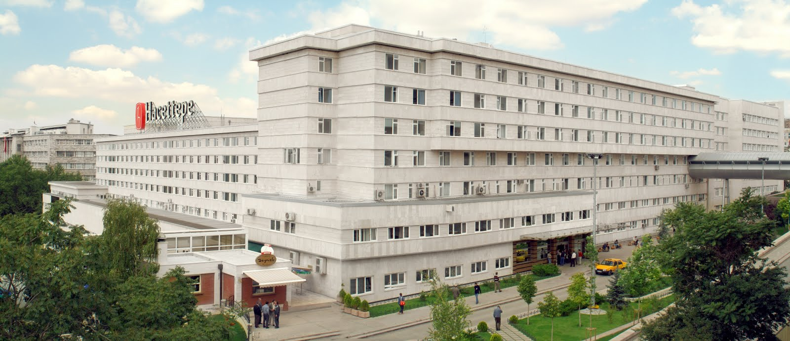
Mehdi Houssein¹, Ahmet Cagkan Inkaya², Cafer Balci³, Mert Esme³, Meliha Cagla Sonmezer ², Meltem Gulhan Halil ³, Serhat Unal²
Hacettepe University School of Medicine, Ankara, Turkey
¹ Department of Internal Medicine
² Department of Infectious Diseases &
Hacettepe HIV/AIDS Treatment and
Research Centre (HATAM)
³ Division of Geriatric Medicine

Slide 3
Disclosure
Nothing to disclose

Slide 4
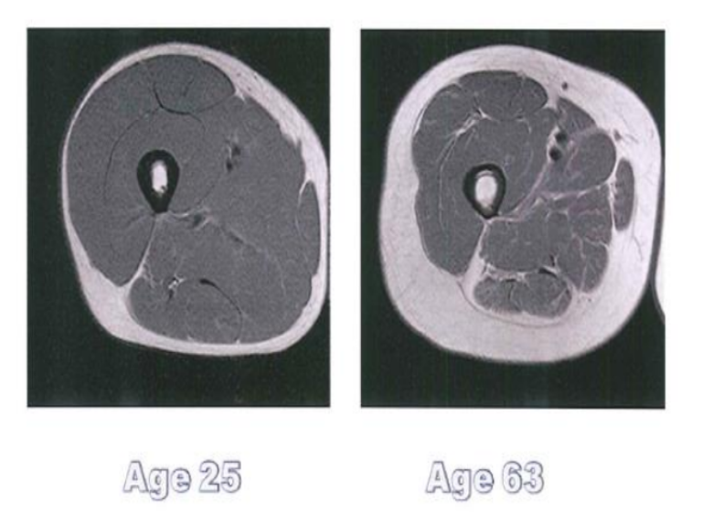
Sarcopenia
Sarx (muscle) + penia (loss)
Muscle loss as a result of ageing
Quantitative
Qualitative

Slide 5
Sarcopenia during the course of HIV infection
ANRS cohort
324 PLWHIV
53% had low performance demonstrated by 5STS
MACS cohort
Men >50
Decreased muscle power and gait speed
PLWHIV vs uninfected controls
Sarcopenia risk X 5.2
Schrack T et al 2015 Accelerated longitudinal gait speed decline in HIV-infected older men J Acquir Immune Defic Syndr
Pinto et al 2016 Human immunodeficiency virus infection and its association with sarcopenia Braz J Infect Dis
Erlandson Y et 2012 Risk factors for falls in HIVinfected persons J Acquir Immune Defic Syndr

Slide 6
Pathogenesis
Pre-ART era
HIV related
ART era
ZDV related mitochondrial toxicity
Inhibition of mtDNA polymerase
Oxidative stress and depletion of L-carnitine
TDF and ABC
Depletion of mtDNA at subcutaneous fat tissue
Pinto et al 2016 Human immunodeficiency virus infection and its association with sarcopenia Braz J Infect Dis

Slide 7
How to define sarcopenia
 | Research | Clinical practice
Muscle Mass | BT MRI DXA BIA K/fat-free mass | BIA DXA Anthropometric analysis
Muscle strenght | Handgrip Knee flex/extension Peak expiratory flow | Handgrip
Physical performance | Short Physical Performance Battery (SPPB) Gait speed Stand & walk test | SPPB Gait speed Stand & walk
European Working Group on Sarcopenia in Older People

Slide 8
Why is sarcopenia important?
Physical disability
Poor quality of life
Morbidity
Death
Hawkins K et al 2017 Geriatric Syndromes: New Frontiers in HIV and Sarcopenia AIDS
Echeverria P etal 2018 High Prevalence of Sarcopenia in HIV-Infected Individuals Patricia Echeverría Biomed Res Int

Slide 9
Why is sarcopenia important?
 | VACS index | VACS 5-year mortality
FFMI | r=0.197 p<0.05 | r=0.196 p=0.051
Phase angle | r=0.258 p<0.05 | r=0.258 p<0.05
Muscle thickness | r=0.273 p<0.001 | r=0.273 p<0.001
Hand grip | r=0.456 p<0.001 | r=0.456 p<0.001
Inkaya AC Unpublished result

Slide 10
Gastrocnemius muscle thickness can serve as a point of care test to screen sarcopenia in PLWHIV

Slide 11
Study design
Hacettepe cohort
6 month (May-October 2018) cross sectional
PLWHIV over 40 years of age

Slide 12
Inclusion Criteria
PLWHIV>40
Stable ART > 3months
HIV RNA < 200 copies/ml
Exclusion Criteria
Active co-infection
CMV
Uncontrolled hepatitis B or C
Acute opportunistic infection
Known heart failure
Recent coronary heart disease / stroke
Exacerbations of COPD
Recent surgery (last 1 month)
Dementia

Slide 13
Ethical approval
Hacettepe University non-interventional studies board
10.4.2017 : GO 18/280-23

Slide 14
Methods
Participant information
From Hacettepe cohort database
Anthropometrics
Height
Weight
Waist circumference
Hip circumference

Slide 15
Methods continued
Bioelectric impedance analysis (BIA)
2 electrodes were placed at right hand & foot
Body composition analysis & FFMI (Fat Free Mass index)
Cut-off defining sarcopenia
-2SD

Slide 16
Methods continued
Hand grip
Takei grip strength dynamometer
Dominant hand
Highest among triple measurements was recorded
Cut-off values defining sarcopenia
Men <30 kg
Women <20 kg

Slide 17
Methods continued
Gastrocnemius muscle thickness
Right medial gastrocnemius muscle ultrasound

Slide 18
Statistics
SPSS v 16
Correlation analysis
Pearson’ test
Spearman’ test
ROC analysis to determine gastrocnemius muscle thickness

Slide 19
Results
 | N=95
Gender | 77% Male
Age | 52.28 ± 8.39
CD4 count (cells/ml) | 574 (39-1389)
Treatment Duration (months) | 60 (6-312)
BMI Waist circumference (cm) | 27.20 ± 4.09 kg /m² 96 ± 10.6
Hip circumference (cm) | 103 ± 7,8

Slide 20
Results
 | Result
FFMI (kg / m² ) | 21 (16.4-27.6)
BFMI (kg / m²) | 5.20 (0.60-20.6)
Hand grip (kg) | 33.9 (14-52.8)
Phase Angle | 7.4 (4.10-22.8)
Gastrocnemius muscle thickness (mm) | 14.2 (8.9-20.7)
Sarcopenia prevalance | 12%

Slide 21
Gastrocnemius thickness / FFMI

Slide 22
Gastrocnemius thickness / hand grip
 |  | Muscle thickness | Hand Grip
Muscle thickness | Pearson Correlation | 1 | ,520**
 | Sig. (2-tailed) |  | ,000
 | N | 95 | 95
Hand grip | Pearson Correlation | ,520** | 1
 | Sig. (2-tailed) | ,000
 | N | 95 | 95
**. Correlation is significant at the 0.01 level (2-tailed).

Slide 23
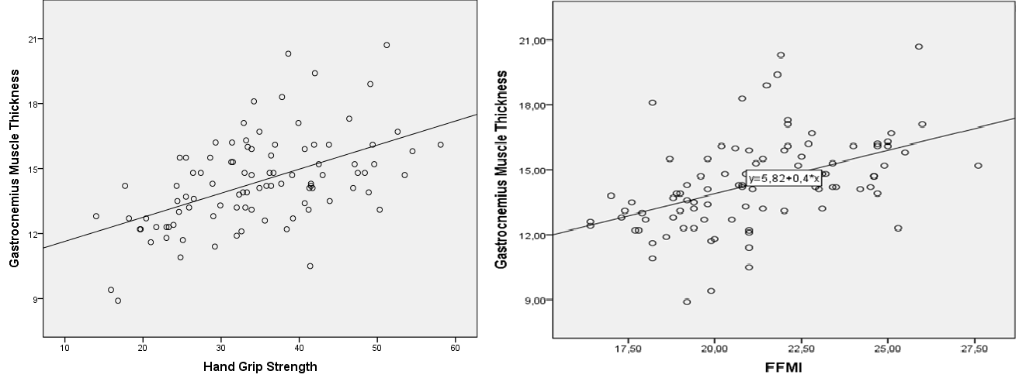

Slide 24
Receiver Operating Characteristic (ROC) analysis
Gastrocnemius Thickness (mm) | Sensitivity | Specifity | Positive predictive value | Negative predictive value
12.9 | 83% | 75%
13.05 | 84% | 83.3% | 42% | 97%
13.15 | 79.5% | 83%

Slide 25
Discussion
Sarcopenia is common among PLWHIV > 40
Measuring gastrocnemius muscle thickness may provide
Quantitative
Qualitative information
Gastrocnemius muscle thickness
Safe
Non-invasive
Unrelated to physical performance
May provide additional information: Pennate angle, fascicule length etc.

Slide 26
Limitation
Single center
Limited number of patients, gender imbalanced
Limited muscle architecture information

Slide 27
Conclusion
Gastrocnemius muscle thickness may serve as a screening test to identify at-risk patients

Slide 28
Acknowledgement
PLWHIV in Hacettepe Cohort
Their enthusiastic contribution to this study
Ozge Karadag Caman, MD, PhD
Statistical analysis

